Slide 1
Smart Energy System Project Architecture
Neha Bari Tamboli, Diego Cabo and Thomas van Dongen

Slide 2
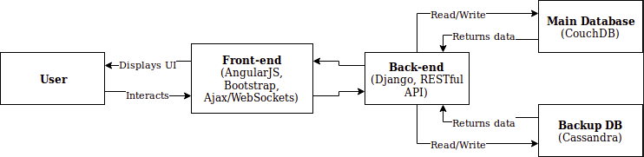
How everything works together

Slide 3
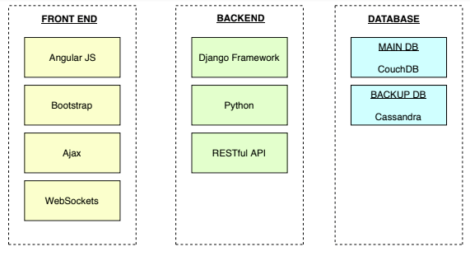
Technology Stack

Slide 4
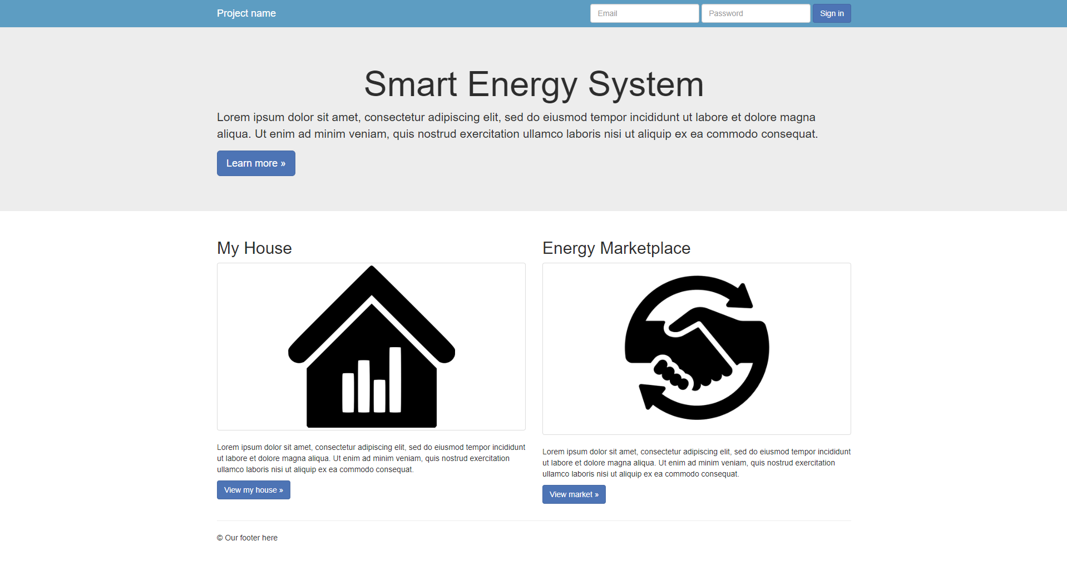
Front end idea

Slide 5
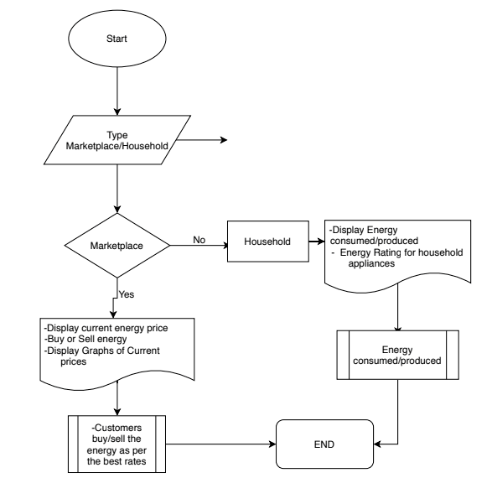
Database

